Slide 1
Java Core Training
By Manuk Gharslyan & Grigor Topchyan

Slide 2
Java Fundamentals
History
JDK and JRE
JDK Tools
Byte Code and JVM (Java Virtual Machine)
Platform Independent
First Java Application

Slide 3
History
Java is a General Purpose, Object Oriented Programming Language developed by Sun Microsystems of USA I 1991.
Created By team leading by Games Gosling.

Slide 4
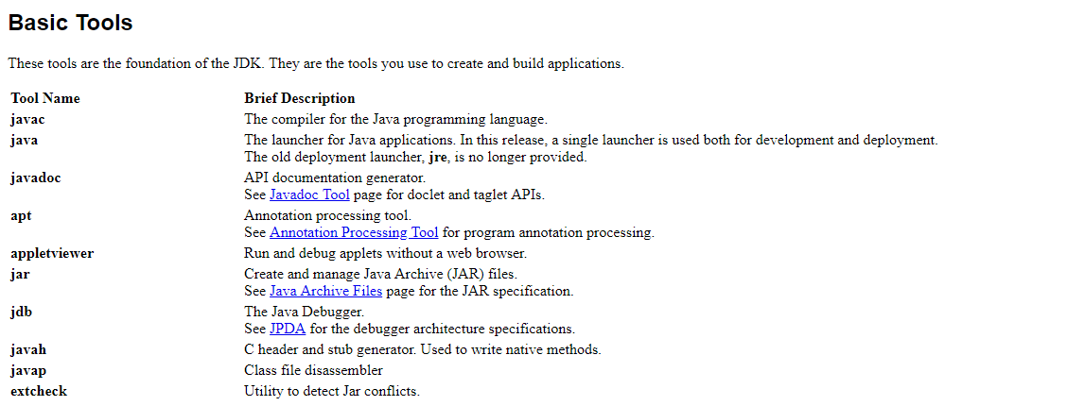
JDK,JRE,JVM

Slide 5
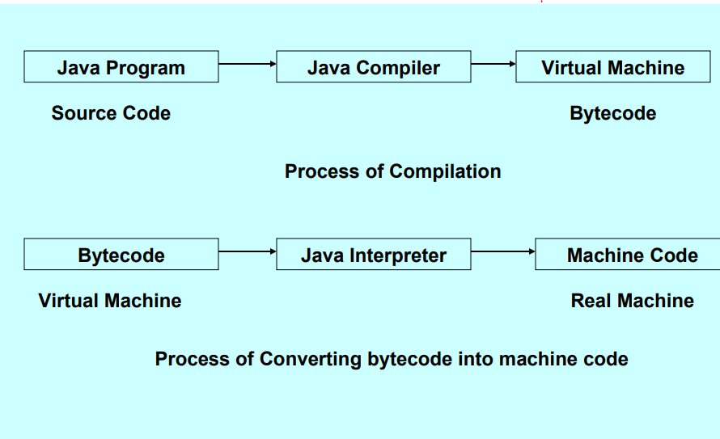
JDK,JRE,JVM
Platform Independent

Slide 6
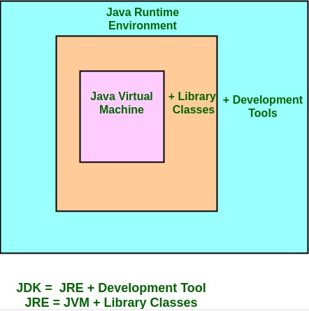
JDK,JRE,JVM
JRE - What it is setup JRE_HOME environment variable Some main packages in Java.
java.lang.* ex. java.lang.String etc.
java.util.* ex. java.util.Scanner etc.
java.io.* ex. java.io.InputStream etc.
How to use import keyword

Slide 7
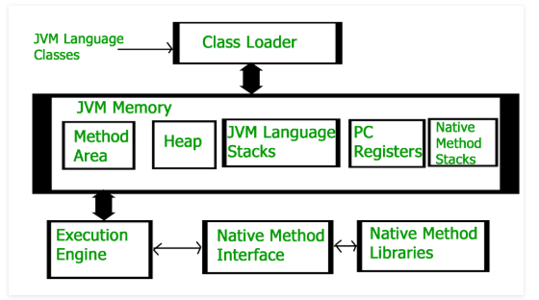
JDK,JRE,JVM
JVM – Java Virtual Machine – What it is HotSpot(Open source implementation of Oracle)

Slide 8
JDK,JRE,JVM
Create first simple “Hello World” project using nodepad ++ (nodepad) and JDK tools. Compile FileName.java file using javac FileName.java Run project using java FileName

Slide 9
Data Types, Variables, and Arrays
Java Is a Strongly Typed Language
The Primitive Types
Reference Types
Integers
Floating-point numbers
Characters
Boolean

Slide 10
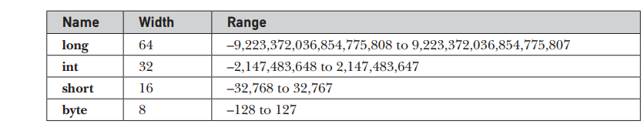
Integers
Java defines four integer types: byte, short, int, and long

Slide 11
byte
The smallest integer type is byte.
This is an 8-bit type that has a range from –128 to 127.
Byte variables are declared by use of the byte keyword.
For example:
byte b, c;

Slide 12
short
short is a signed 16-bit type.
It has a range from –32,768 to 32,767.
Here are some examples of short variable declarations: short s; short t;

Slide 13
int
The most commonly used integer type is int.
It is a 32-bit type.
It has a range from –2,147,483,648 to 2,147,483,647.

Slide 14
long
long is a signed 64-bit type.
It is useful for those occasions where an int type is not large enough to hold the desired value.

Slide 15
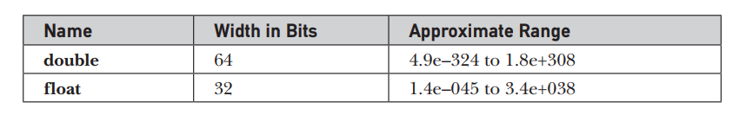
Floating-Point Types
Floating-point numbers, also known as real numbers, are used when evaluating expressions that require fractional precision.
For example, calculations such as square root.

Slide 16
float
The type float specifies a single-precision value that uses 32 bits of storage Here are some example float variable declarations:
float hightemp, lowtemp;

Slide 17
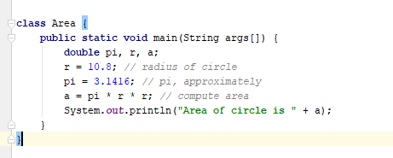
double
double precision, as denoted by the double keyword, uses 64 bits to store a value
It is used for high-speed mathematical calculations such as
sin( ), cos( ), and sqrt( )

Slide 18
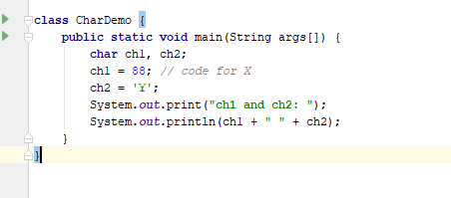
Characters
In Java, the data type used to store characters is char
char is a 16-bit type.
The range of a char is 0 to 65,536

Slide 19
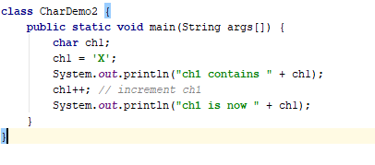
Characters
char variables behave like integers.

Slide 20
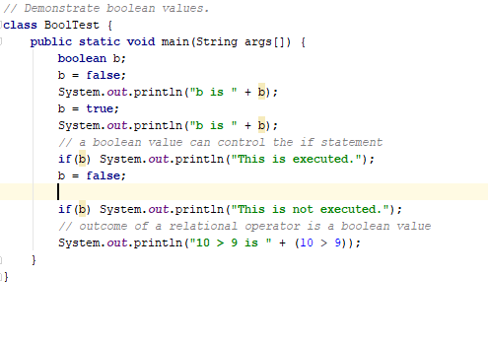
Booleans
Java has a primitive type, called boolean, for logical values
It can have only one of two possible values, true or false

Slide 21
Literals
Integer Literals
Floating-Point Literals
Boolean Literals
Character Literals
String Literals

Slide 22
Integer Literals
int x = 0b1010;
int x = 123_456_789;
int x = 123___456___789;
int x = 0b1101_0101_0001_1010;

Slide 23
Floating-Point Literals
double num = 9_423_497_862.0;
double num = 9_423_497.1_0_9;

Slide 24
Boolean Literals
There are only two logical values that a boolean value can have, true and false

Slide 25
Character Literals
char a = ‘a’;
char b = ‘b’;

Slide 26
String Literals
String greeting = "Hello World"

Slide 27
Operators in Java
Arithmetic Operators
Unary Operators
Assignment Operator
Relational Operators
Logical Operators
Ternary Operator
Bitwise Operators
Shift Operators
instance of operator
Precedence and Associativity
Interesting Questions

Slide 28
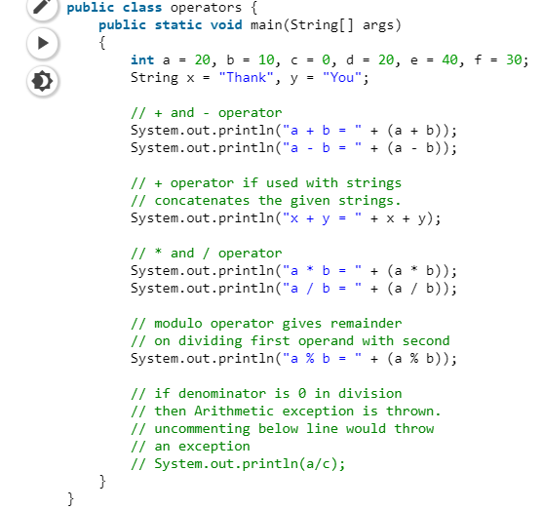
Arithmetic Operators
Arithmetic Operators: They are used to perform simple arithmetic operations on primitive data types.
* : Multiplication
/ : Division
% : Modulo
+ : Addition
– : Subtraction

Slide 29
Unary Operators
Unary Operators: Unary operators needs only one operand. They are used to increment, decrement or negate a value.
– :Unary minus, used for negating the values.
+ :Unary plus, used for giving positive values. Only used when deliberately converting a negative value to positive.
++ :Increment operator, used for incrementing the value by 1. There are two varieties of increment operator.
Post-Increment : Value is first used for computing the result and then incremented.
Pre-Increment : Value is incremented first and then result is computed.
— : Decrement operator, used for decrementing the value by 1. There are two varieties of decrement operator.
Post-decrement : Value is first used for computing the result and then decremented.
Pre-Decrement : Value is decremented first and then result is computed.
! : Logical not operator, used for inverting a Boolean value.

Slide 30
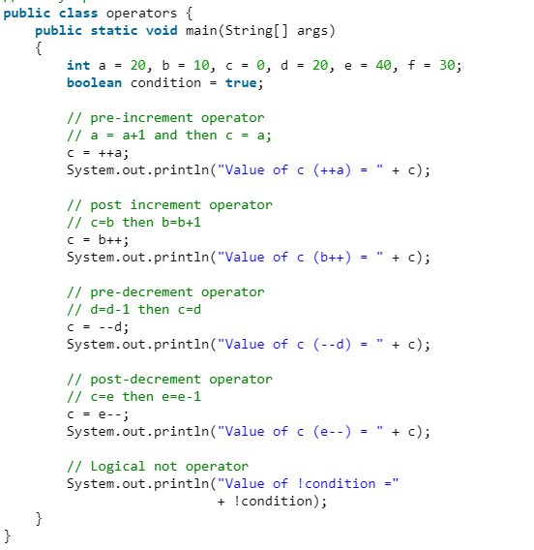
Unary Operators

Slide 31
Assignment Operator
Assignment Operator : ‘=’ Assignment operator is used to assign a value to any variable.
+=, for adding left operand with right operand and then assigning it to variable on the left.
-=, for subtracting left operand with right operand and then assigning it to variable on the left.
*=, for multiplying left operand with right operand and then assigning it to variable on the left.
/=, for dividing left operand with right operand and then assigning it to variable on the left.
%=, for assigning modulo of left operand with right operand and then assigning it to variable on the left.

Slide 32
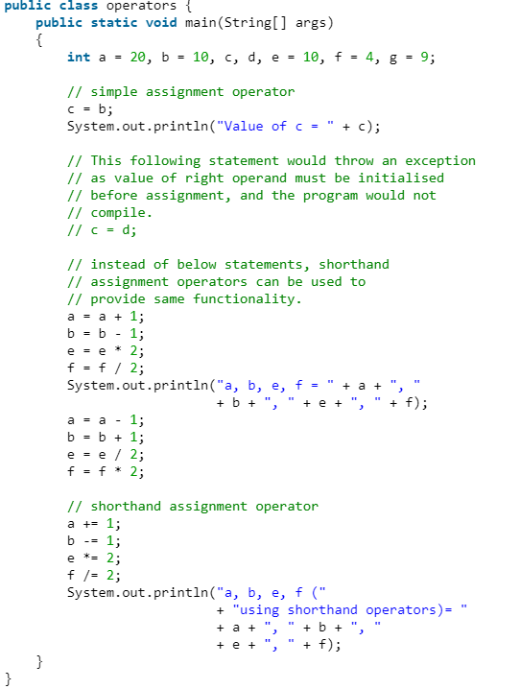
Assignment Operator

Slide 33
Relational Operators
Relational Operators : These operators are used to check for relations like equality, greater than, less than.
!=, Not Equal to : returns true of left hand side is not equal to right hand side.
<, less than : returns true of left hand side is less than right hand side.
<=, less than or equal to : returns true of left hand side is less than or equal to right hand side.
>, Greater than : returns true of left hand side is greater than right hand side.
>=, Greater than or equal to: returns true of left hand side is greater than or equal to right hand side.

Slide 34
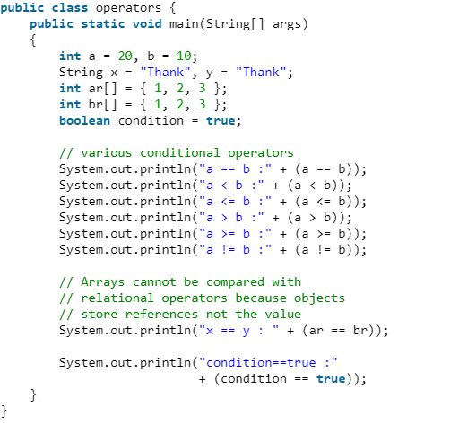
Relational Operators

Slide 35
Statements, Using Relational Operators
if statement
if..else statements
nested if statements
if-else-if ladder
switch statements

Slide 36
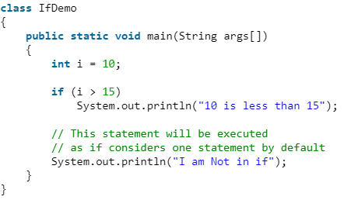
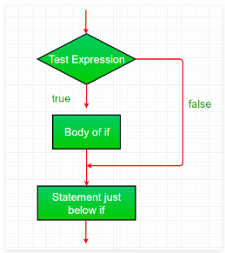
if statement

Slide 37
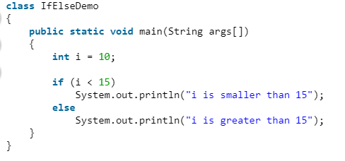
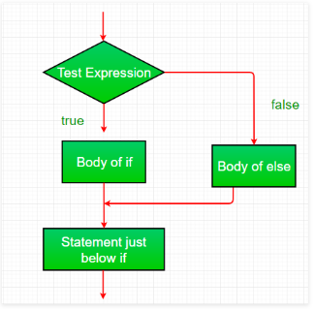
If..else statement

Slide 38
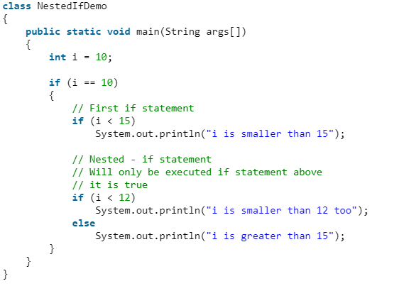
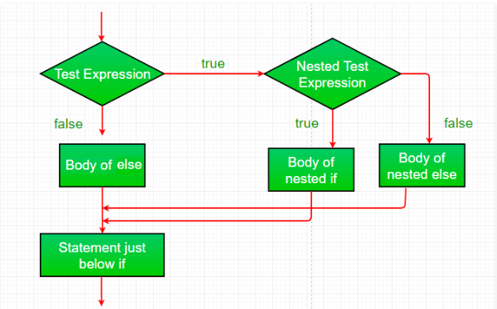
Nested if statement

Slide 39
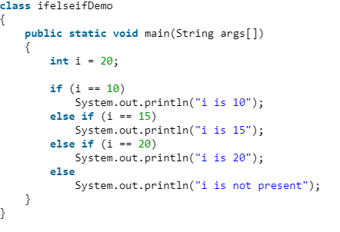
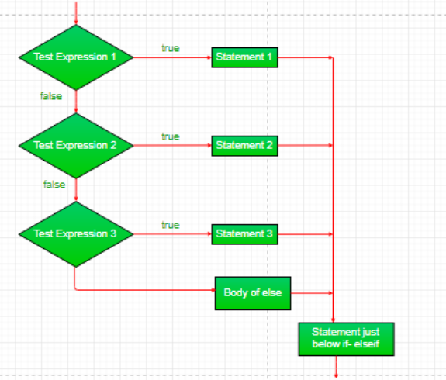
If - else if statement

Slide 40
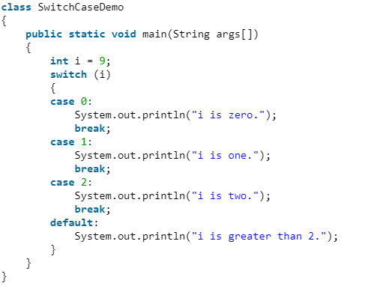
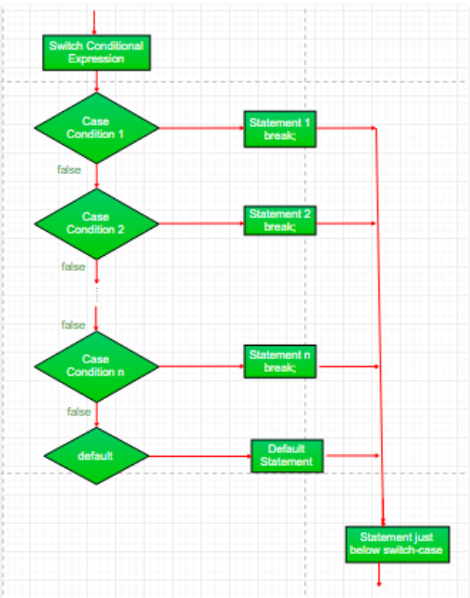
Switch-case statement
Expression can be of type byte, short, int char or an enumeration. Beginning with JDK7, expression can also be of type String.
Duplicate case values are not allowed.
The default statement is optional.
The break statement is used inside the switch to terminate a statement sequence.
The break statement is optional. If omitted, execution will continue on into the next case.

Slide 41
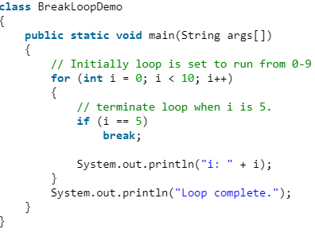
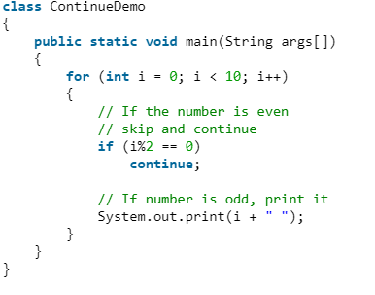
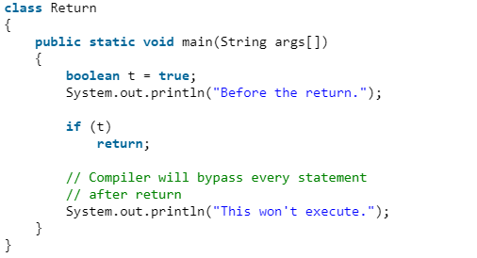
Jump – break, continue, return

Slide 42
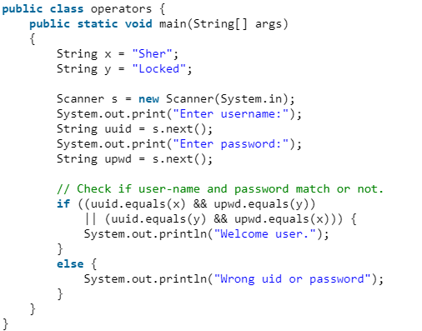
Logical Operators
Logical Operators : These operators are used to perform “logical AND” and “logical OR” operation, i.e. the function similar to AND gate and OR gate in digital electronics.
&&, Logical AND : returns true when both conditions are true.
||, Logical OR : returns true if at least one condition is true.

Slide 43
Loops – for, while, do-whil
While
Do – While
For

Slide 44
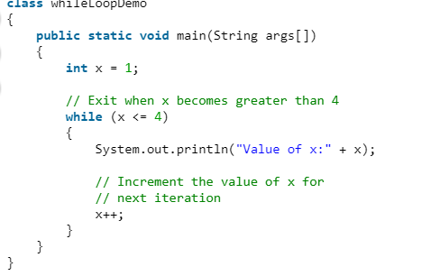
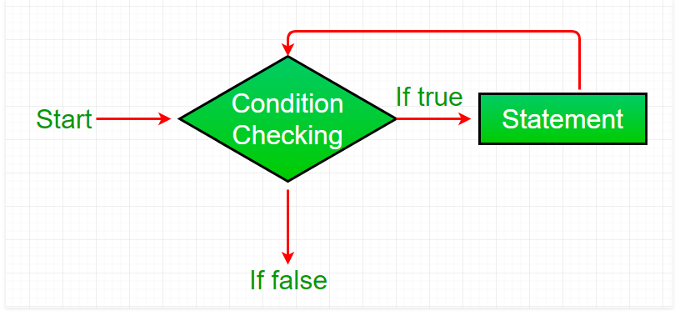
While

Slide 45
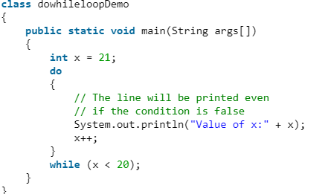
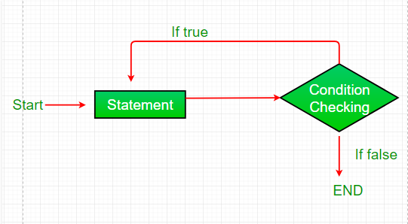
Do-While

Slide 46
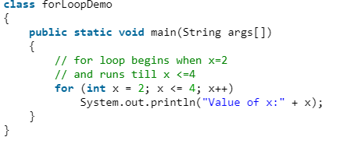
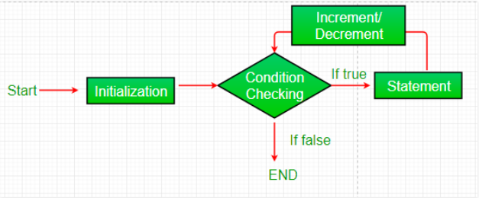
For

Slide 47

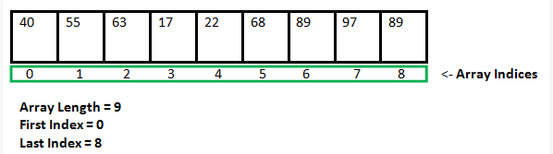
Arrays in java
In Java all arrays are dynamically allocated.(discussed below)
Since arrays are objects in Java, we can find their length using member length. This is different from C/C++ where we find length using sizeof.
A Java array variable can also be declared like other variables with [] after the data type.
The variables in the array are ordered and each have an index beginning from 0.
Java array can be also be used as a static field, a local variable or a method parameter.
The size of an array must be specified by an int value and not long or short.
The direct superclass of an array type is Object.
Every array type implements the interfaces Cloneable and java.io.Serializable.

Slide 48
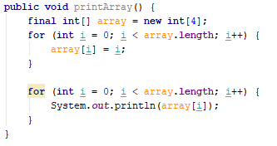

Arrays in Java

Slide 49
Class and Object
A class is a user-defined data type with the template that serves to define its properties.
A class defines new data type. Once defined, this new data type can be used to create objects of that type.
Class is a template for an object and object is the instance of the class.

Slide 50
Class definition
class class-name {
data-type instance-variable1;
- - - - -;
data-type instance-variableN;
data-type method-name1(parameter-list) {
//body of the method1
}
- - - - -;
data-type method-nameN(parameter-list) {
//body of the methodN
}
}

Slide 51
Adding variables to class
class Country {
long population;
float currencyRate;
int noOfStates;
}

Slide 52
Creating objects
Creating the objects of the class is also called as instantiating an object.
Example:
Country japan; // declaration
japan = new Country(); // instantiation or
Country japan = new Country();

Slide 53
Accessing members
Member access follows the following syntax:
objectname.variablename Example: japan.population = 58612453;
japan.noOfSates = 5;

Slide 54
Adding methods
The general form of the declaration of the method is,
data-type method-name (parameter-list) {
Body of the method;
}
The method declaration contains four different parts:
● Name of the method (method-name)
● Data type of the values returned by method (data-type)
● The list of parameters (parameter-list)
● Body of the method

Slide 55
What is a method?
float area(int radius) {
final float pi = 3.14f;
float val;
val = pi * (float) (radius * radius);
return(val);
}

Slide 56
Constructor
● A constructor initializes an object immediately upon creation.
● It has the same name as the class in which it resides and it is syntactically similar to a method.
● Once defined, the constructor is automatically called immediately after the object is created, before the new operator completes.
● Constructors look a little strange because they have no return type, not even void. Type of constructors: ● Default constructor
● Parameterized constructor

Slide 57
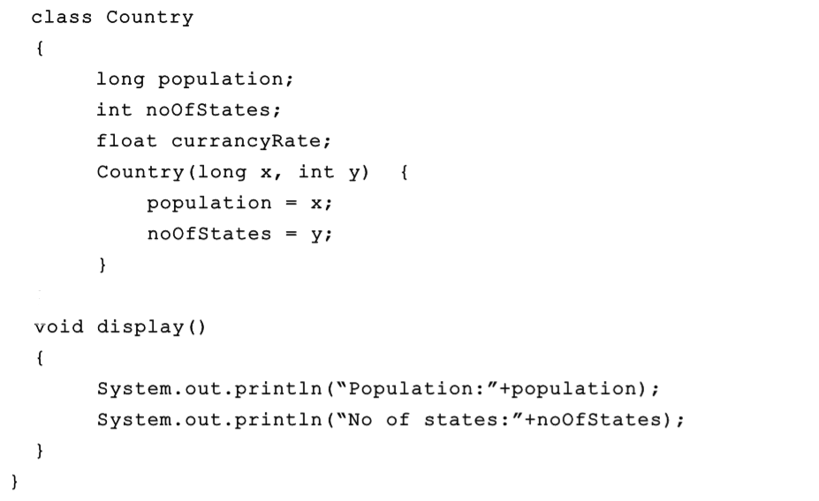
Constructor

